Slide 1
IEEE CNOM/IFIP WG6.6 Meeting
CNSM 2015 Barcelona, Spain IEEE CNOM/IFIP WG6.6 Meeting
November 11, 2015 – 17:00-18:00

Slide 2
CNOM / IFIP WG 6.6 officers
IEEE CNOM
Chair: Lisandro Zambenedetti Granville – Federal University of Rio Grande do Sul (UFRGS), Brazil
Vice-chair: Filip De Turck – Ghent University - iMinds, Belgium
TPC chair: Deep Medhi – University of Missouri-Kansas City, USA
Secretary: Shingo Ata – Osaka City University, Japan
IFIP WG 6.6
Chair: Olivier Festor – INRIA, France
Vice-chair: Burkhard Stiller – University of Zürich, Switzerland

Slide 3
Meeting Overview
Overview of journals +special issues + conferences + workshops
TNSM indexed in Science Citation Index and Journal Citation Reports
Questionnaire results + taxonomy update
Open Digital Library
Introduction of Test-of-time award
Idea to organize 'Industry-oriented special section' in journal

Slide 4
IEEE Transactions on Network and Service Management (TNSM)
New Editor-in-Chief since Jan 2014
Rolf Stadler (stadler@kth.se) KTH Royal Institute of Technology
http://www.comsoc.org/tnsm/
Within our community, highest reputation
TNSM is indexed by Scopus and many others
 | 2009 | 2010 | 2011 | 2012 | 2013 | 2014 | 2015
SJR | 0.261 | 0.49 | 0.426 | 0.858 | 0.502 | 1,51
SNIP | 0.977 | 1.159 | 1.302 | 2.598 | 1.489
Citations | 33 | 79 | 159 | 223 | 279 | 1015
Notes:
SNIP: Source Normalized Impact per Paper

Slide 5
Commag Network and Service Management Series
Feature Editors
George Pavlou g.pavlou@ee.ucl.ac.uk University College London
Jürgen Schönwälder j.schoenwaelder@jacobs-university.de Jacobs University Bremen

Slide 6
ComMag Network and Service Management Series (cont.)
Issue | Published | Submitted | Accepted | Acc. ratio
1 | October 2005 | 21 | 4 | 19%
2 | March 2006 | 23 | 5 | 22%
3 | October 2006 | 17 | 4 | 24%
4 | April 2007 | 23 | 4 | 17%
5 | October 2007 | 14 | 4 | 29%
6 | April 2008 | 32 | 5 | 16%
7 | October 2008 | 23 | 4 | 17%
8 | July 2009 | 29 | 4 | 14%
9 | November 2009* | 21 | 1 | 5%

Slide 7
ComMag Network and Service Management Series (cont.)
Issue | Published | Submitted | Accepted | Acc. ratio
10 | July 2010 | 21 | 3 | 14%
11 | December 2010 | 22 | 3 | 14%
12 | July 2011 | 22 | 4 | 18%
13 | December 2011 | 35 | 4 | 11%
14 | July 2012 | 20 | 5 | 25%
15 | December 2012 | 13 | 3 | 23%
16 | July 2013 | 21 | 4 | 19%
17 | December 2013 | 22 | 5 | 23%
18 | July 2014 | 22 | 4 | 18%
19 | January 2015 | 18 | 3 | 17%
20 | July 2015 | 16 | 4 | 25%
21 | January 2016 | 28 | 4 | 14,3%

Slide 8
Journal of Network and Systems Management
EiC: Deep Medhi (DMedhi@umkc.edu)
Published by Springer / 4 x year
Acceptance rate of 15% (2013~2014): ~33 paper/year
Average time of review: 70 days
Average time of accepted papers (multiple review cycles): 109 days
ISI impact factor:
0.685 (2008)
1.356 (2009)
0.450 (2010)
0.452 (2011)
0.432 (2012)
0.438 (2013)
0.796 (2014)

Slide 9
International Journal of Network Management
EiC: James Hong (started in Jan. 2012)
Ass. Ed: Aiko Pras
Published by Wiley / 6 x year
Since 2011: online only
ISI impact factor:
0.323 (2010)
0.222 (2011)
0.510 (2012)
0.517 (2013)
0.283 (2014)

Slide 10
Journal Special Issues
TNSM:
Big Data Analytics for Management (11/2015 for submission)
Management of Softwarized Networks (02/15/2016 submission deadline)
IJNM:
Software-Defined Networking and Network Function Virtualization for Flexible Network Management (closed 07/2015)
Software-Defined Operations (closed 08/2015)
Management of the Internet of Things and Big Data (November 30, 2015 submission deadline)

Slide 11
2015 Conferences
TMA 2015 (IFIP)
April 23-24, Barcelona, Spain
IM 2015 (IFIP/IEEE)
May 11-15, 2015, Ottawa, Canada
AIMS 2015 (IFIP)
June 22-26, Ghent, Belgium
APNOMS (IEEE)
August 19-21, 2015, Busan, Korea
LANOMS (IEEE)
October 1-2, Paraíba, Brazil
CNSM 2015 (IFIP/IEEE)
November 9-13, Barcelona, Spain

Slide 12
2015 Conferences
 | Submitted | Accepted | A.R. | Attendees | Proceedings
CNSM 2015 | 102 (87 Full, 15 short) | 18 full, 14 miniconf, 16 posters | 20,6% | 120 | LNCS
LANOMS 2015 | 33 | 12 Long / 7 Short | 36% | 58 | XPlore
AIMS 2015 | 22 (+24 PhD WS) | 7 (+9 PhDWS) | 31% | 52 | LNCS
IM 2015 | 206 | 56 | 27% | 350 | Xplore
DRCN 2015 | 44 (full) + 16 (short) | 21 (+19 short) | 41% | 91 | Xplore
TMA 2015 | 54 | 16 | 29% | 80 | LNCS
APNOMS 2015 | 129 | 38 | 29% | 182 | Xplore

Slide 13
TMA 2015
April 23 - 24, 2015
Barcelona, Spain
TPC Co-chairs
M. Steiner, Akamai,
P. Barlet-Ros, UPC
O. Bonaventure, UCLouvain
54 submitted, 16 published
3 collocated-workshops
SMART, mPlane, PhD Shool on Traffic Monitoring and Analysis

Slide 14
IM 2015
May 11 - 15, 2015
Ottawa Convention Centre, Ottawa, Ontario, Canada
General Co-chairs
Raouf Boutaba
Wahab Almutahadi
TPC Co-chairs
Shingo Ata
Rémi Badonnel
Jin Xiao
206 full papers submitted
56 main conference full papers accepted
36 mini-conference papers accepted
For the first time in history of IM, proceedings were available online before the conference: http://dl.ifip.org/db/conf/im/index.html

Slide 15
AIMS 2015
General Co-Chair
Filip De Turck, Ghent University
Piet Demeester, Ghent University
TPC Co-Chairs
Steven Latré, University of Antwerp - iMinds, Belgium
Marinos Charalambides, University College London, United Kingdom
Ph.D. Workshop Chairs
Jérôme François, INRIA, France
Corinna Schmitt, University of Zurich, Switzerland
22 papers submitted
7 papers accepted
24 Ph.D. workshop papers submitted
9 papers accepted
Notes:
TPC Chairs notified to send data and register on Kevin Almeroth’s page.

Slide 16
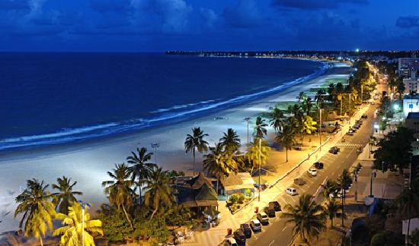
LANOMS 2015
October 01-03, 2015, João Pessoa, Brazil
General Chair
Fernando Menezes Matos, UFPB, Brazil
Augusto Venâncio Neto, UFRB, Brazil
TPC Co-Chairs
José Neuman de Souza, UFC, Brazil
Aldri Santos, UFPR, Brazil
Notes:
Fernando Matos notified on november 8 for data and UCSB data registration

Slide 17
CNSM 2015
November 9-13, 2015, Barcelona, Spain
General Chair
Joan Serrat, Universitat Politècnica de Catalunya, Spain
TPC Co-Chairs
Mauro Tortonesi, University of Ferrara, Italy
Jürgen Schönwälder, Jacobs University Bremen, Germany

Slide 18
Future Conferences
TMA 2016 (IFIP)
April 7-8, 2016, Louvain La Neuve, Belgium
NOMS 2016 (IEEE/IFIP)
April 25-29, 2015, Istanbul, Turkey
Deadline: September 1st, 2015
Dissertation Session - still open for submissions! November 20, 2015
AIMS 2016 (IFIP)
June 20-24, 2016, Munich, Germany
CNSM 2016 (IFIP/IEEE) + In cooperation with ACM SIGCOMM
IM 2017 (IFIP/IEEE): Lisbon, Portugal
Notes:
DRCN did not apply for support in 2016. Calls are out, web as well. Fully under IEEE and IEEE COMSOC.

Slide 19
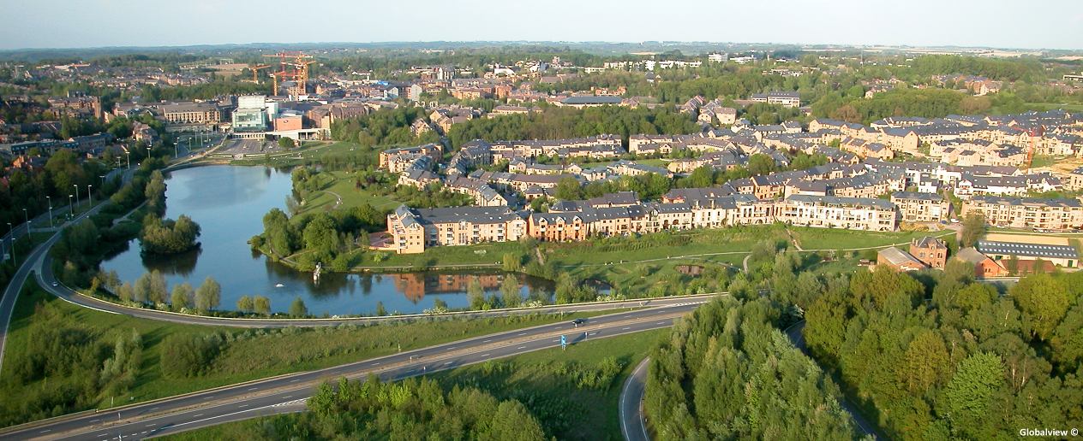
TMA 2016
April 7-8, 2016, Louvain La Neuve, Belgium
Ramin Sadre, Université catholique de Louvain, Belgium
Fabiàn Bustamante, Northwestern University, IL , USA
Alessio Botta, University of Napoli Federico II, Italy
TMA will use the IFIP Digital Library
Submission deadline: December 1st, 2015 (extension planned for)
Notification: January 18th, 2016
Camera Ready, January 29, 2016
Notes:
tma.ifip.org/

Slide 20
NOMS 2016
April 25-29, 2016, Istanbul, Turkey
General Chair
Sema Oktug, Istanbul Technical University, Turkey
Mehmet Ulema, Manhattan College, USA
TPC Co-Chairs
Brendan Jennings, Waterford Institute of Technology, Ireland
Melike Erol-Kantarci, Clarkson University, USA
Helmut Reiser, Ludwig-Maximilians University, Germany

Slide 21
AIMS 2016 (10th edition)
June 20-24, 2016, UniBwM München, Germany
General Co-Chair
Gabi Dreo Rodosek, UniBWM
TPC Co-Chairs
Rémi Badonnel, Inria, France
Robert, Koch UniBWM
Ph.D. Workshop Chairs
Martin Drasar, Masaryk University, Czech Republic
Aiko Pras, University of Twente, Netherlands
Paper submission deadline: January 8, 2016 (Registration), Janaury 15, 2015 (Uploading)
Notification: March 1, 2016
Camera Ready: March 14, 2016
Notes:
AIMS publishes with LNCS.

Slide 22
NOMS 2016
213 papers submitted (general track)
7 Workshops (workshops deadline still all open until December 15, 2015)
5GMan 2016
AnNet 2016
DISSECT 2016
ManFI 2016
ManFIoT 2016
PASC 2016
UMITS 2016

Slide 23
IEEE Transactions on Network and Service Management (TNSM)
Recognition Achievement
Beginning with V. 10 (1) 2013, TNSM papers will be indexed and abstracted in the Thomson Reuter - Science Citation Index.

Slide 24
Questionnaire + taxonomy update

Slide 25
Why a taxonomy?
Select appropriate topics at submission time
Attract papers on key management areas
Match with reviewers’ expertise and interest
Analysis of topics of submitted papers to conferences and journals

Slide 26
Questionnaire: setup and participants

Slide 27
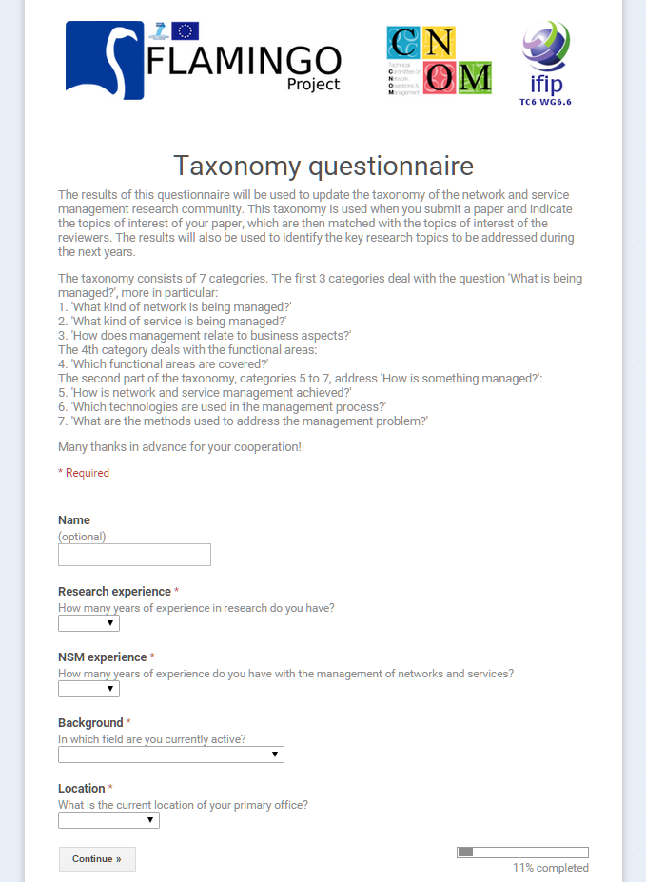

Slide 28
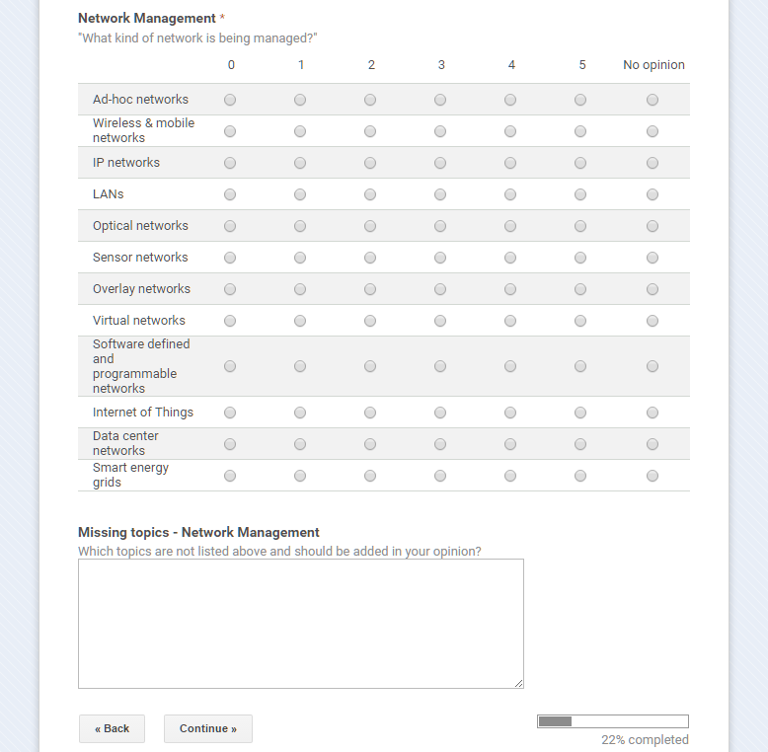

Slide 29
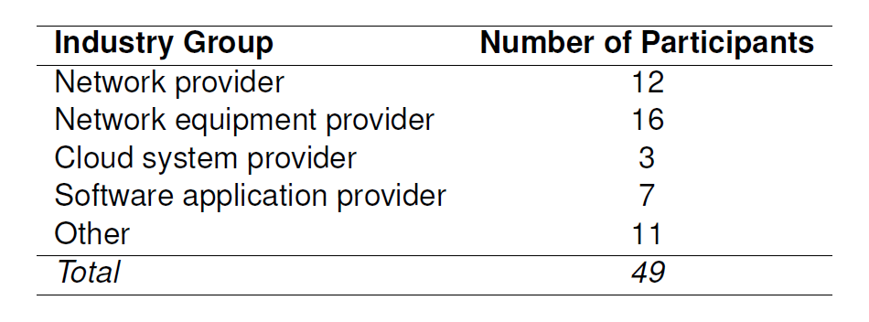
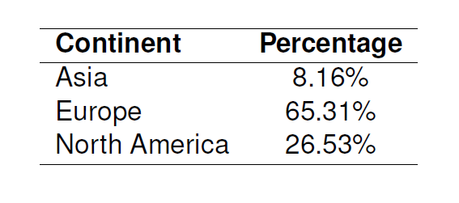
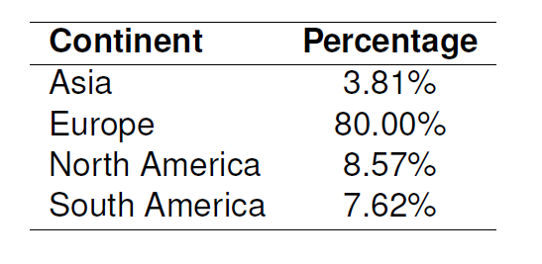
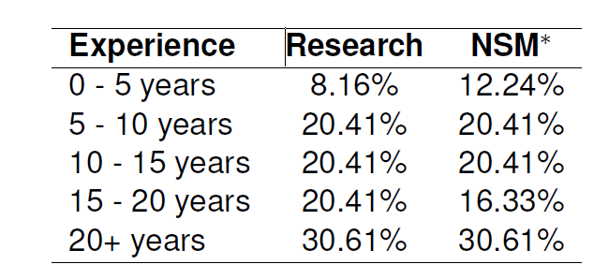
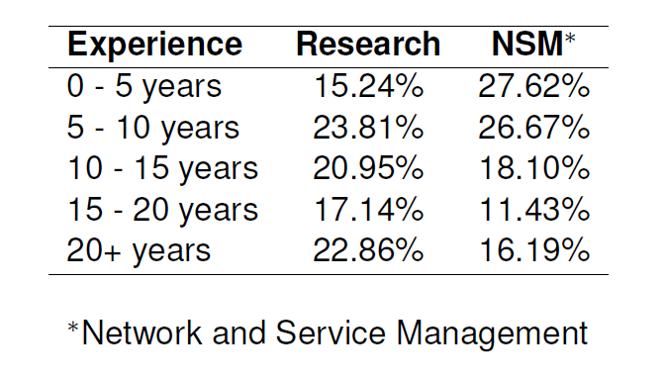
Questionnaire participants
154 = 49 (industry) + 105 (academia)

Slide 30
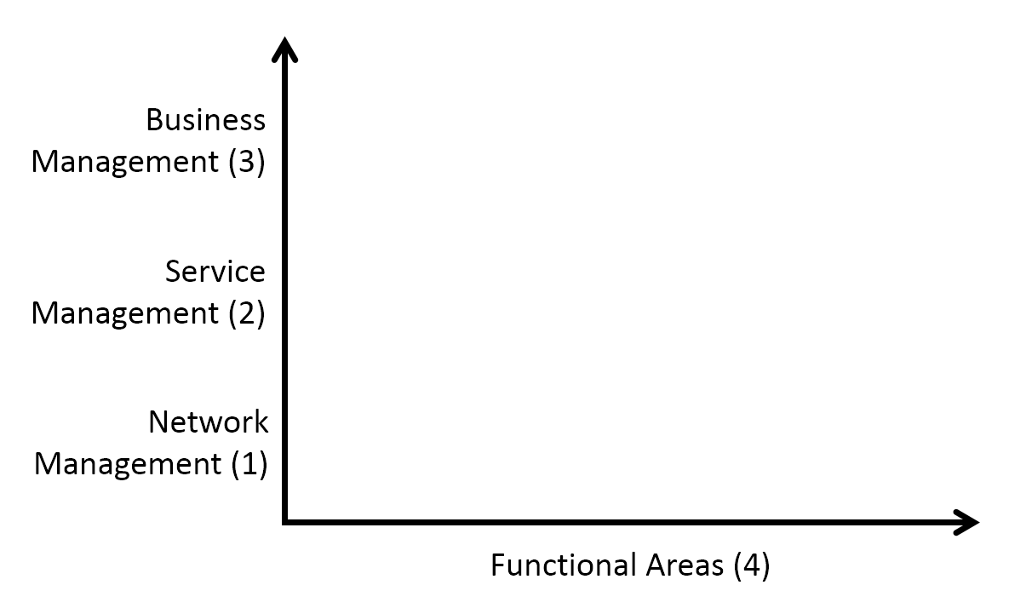
Categories 1-3:
What is being managed?
How does mgmt relate to business aspects?
What kind of service is being managed?
What kind of network is being managed?
Category 4:
Which functional areas are covered?

Slide 31
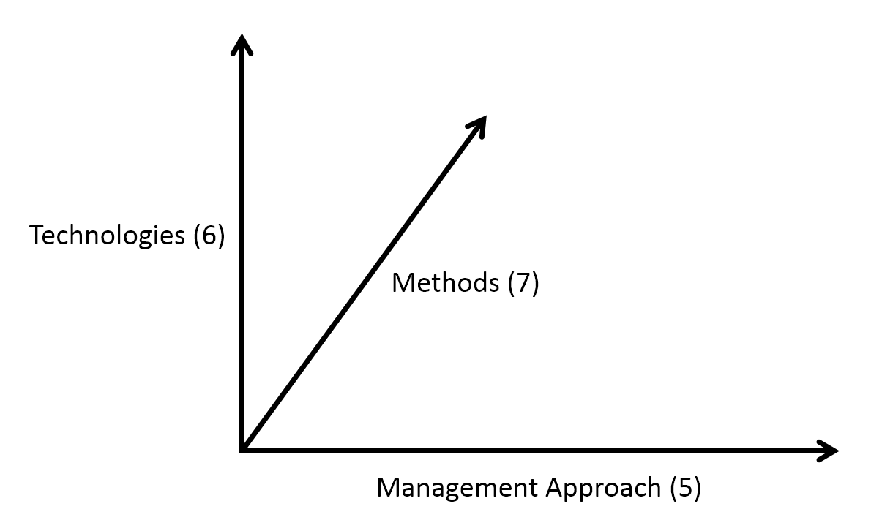
Categories 5-7:
How is something managed?
Which are the methods used to address the management problem?
Which technologies are used in the management process?
How is network and service management achieved?

Slide 32
Taxonomy: category by category

Slide 33
1. Network Management
Ad-hoc Networks
Wireless and Cellular Networks (incl. 5G)
IP Networks
LANs
Optical Networks
Sensor Networks
Overlay Networks
Virtual Networks
Software Defined and Programmable Networks
Internet of Things (M)
Data Center Networks
SCADA and Distributed Control Systems
Information-Centric-Networks
Network Function Virtualization (R)
Home Networks

Slide 34
2. Service Management
Multimedia Services (incl. Voice, Video)
Content Delivery Services
Hosting (Virtual Machines) (R)
Cloud Services (incl. IaaS, PaaS, SaaS)
IoT Services (N)
Grid Services (R)
Security Services (N)
Context-aware Services
IT Services

Slide 35
3. Business Management
Legal Perspective
Regulatory Perspective (N)
Ethical Issues (R)
Economic Aspects (N)
Process, Workflow and Life-cycle Management
Privacy Management
SLA Management (M)

Slide 36
4. Functional Areas
Fault Management
Configuration Management (incl. Deployment Management)
Accounting Management
Performance Management
Security Management (incl. IDS, DDoS detection and Mitigation)
Event Management (R)

Slide 37
5. Management Paradigms
Centralized Management
Hierarchical Management
Distributed Management
Autonomic and Cognitive Management
Policy-Based Management
Federated Network Management
Pro-Active Management
Energy-Aware Network Management
QoE-Centric Management (M)

Slide 38
6. Technologies
Protocols
Middleware
Overlays (incl. P2P)
Data, Information, and Semantic Modeling
Mobile Agents (R)
Grids (R)
Service Discovery, Migration and Orchestration
Resource Provisioning (R)
Software Defined Networking (N)
Network Function Virtualization (N)
Cloud Computing and Storage
Human-Machine Interaction (R)
Information Visualization
Operations and Business Support Systems (OSS/BSS)

Slide 39
7. Methods
Control Theory
Mathematical Optimization
Economic Theories (incl. Game Theory)
Machine Learning and Evolutionary Algorithms
Monitoring and Measurements
Data Mining and (Big) Data Analytics
Logic and Reasoning
Probability Theory, Stochastic Processes, Queuing Theory
Simulators and Simulation Experiments
Prototypes and Testbed Experimentation
Field Trials

Slide 40
Open Digital Library

Slide 41
Introduction of Test-of-time award

Slide 42
Idea to organize 'Industry-oriented special section' in journal

Slide 43
IEEE CNOM/IFIP WG6.6 Meeting Thank You!!!
CNSM 2015 Barcelona, Spain IEEE CNOM/IFIP WG6.6 Meeting
November 11, 2015 – 17:00-18:00

